Slide 1


Slide 2
PROJECT TEAM
MOTIVATION

Slide 3
Defining Motivation
Motivation refers to the process by which a person’s efforts are energized, directed and sustained towards attaining a goal.
Motivation is a force that energizes behavior, gives direction to behavior, and underlies the tendency to persist.
Key Elements. The three key elements of our definition
are intensity, direction, and persistence:
Intensity. How hard a person tries.
Direction. Toward beneficial goals.
Persistence. How long a person tries.

Slide 4
Early Theories of Motivation
In the 1950s three specific theories were formulated and are the best known - hierarch of needs theory, theories X and Y, and the two-factor theory.
These early theories are important to understand because they represent a foundation from which contemporary theories have grown. Practicing managers still regularly use these theories and their terminology in explaining employee motivation.

Slide 5
Maslow’s Hierarchy of Needs Theory
There is a hierarchy of five needs:
  Physiological Needs. Includes hunger, thirst, shelter and other bodily needs.
  Safety Needs. Includes security and protection from physical and emotional harm.
  Social/ Belongingness Needs. Includes affection, belongingness, acceptance, family and friendship.
  Esteem. Includes internal esteem factors such as self-respect, autonomy, and achievement; and external esteem factors such as status, recognition, and attention.
  Self-actualization. The drive to become what one is capable of becoming; includes growth, achieving one’s potential, and self-fulfillment.

Slide 6
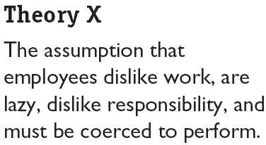

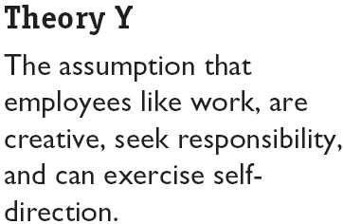

Theory X and Theory Y (Douglas McGregor)

Slide 7
Theory X and Theory (McGregor)
McGregor concluded that a manager’s view of the nature of human beings is based on a certain grouping of assumptions and he or she tends to mold his or her behavior toward employees according to the assumptions. Theory X. Theory X assumptions are basically negative: Employees inherently dislike work and, whenever possible, will attempt to avoid it. Since employees dislike work, they must be coerced, controlled, or threatened with punishment. Employees will avoid responsibilities and seek formal direction whenever possible. Most workers place security above all other factors and will display little ambition.
Conti…

Slide 8
Theory X and Theory Y (Cont’d)
Theory Y. Theory Y assumptions are basically positive: Employees can view work as being as natural as rest or play. People will exercise self-direction and self-control if they are committed to the objectives. The average person can learn to accept, even seek, responsibility. The ability to make innovative decisions is widely dispersed throughout the population.

Slide 9
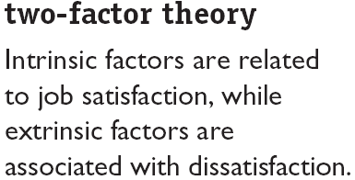

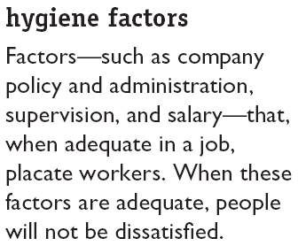
Two-Factor Theory (Frederick Herzberg)
/ Also called Motivation-hygiene theory

Slide 10
Comparison of Satisfiers and Dissatisfiers
Frederick Herzberg asked people to describe, in detail, situations in which they felt exceptionally good or bad about their jobs. These responses were then tabulated and categorized:
Hygiene Factors “Factors characterizing events on the job that lead to extreme job dissatisfaction” | Motivators “Factors characterizing events on the job that lead to extreme job satisfaction”
Pay Policies Working conditions Supervisors Company policies Benefits (Extrinsic Rewards) | Achievements Responsibility Work itself Recognition Advancement Growth (Intrinsic Rewards)

Slide 11
Contrasting Views of Satisfaction
and Dissatisfaction
From the categorized responses, Herzberg concluded:
  Intrinsic factors, such as advancement, recognition, responsibility, and achievement seem to be related to job satisfaction.
  Dissatisfied respondents tended to cite extrinsic factors, such as supervision, pay, company policies, and working conditions.
  Removing dissatisfying characteristics from a job does not necessarily make the job satisfying.

Slide 12
Contemporary Theories of Motivation
The following theories are considered contemporary
not because they necessarily were developed
recently, but because they represent the current
state of the art in explaining employee motivation:
  ERG Theory
  Theory of Needs
  Goal-setting Theory
  Reinforcement Theory
  Job design Theory
  Equity Theory
  Expectancy Theory

Slide 13
ERG Theory (Clayton Alderfer)
ERG Theory: Clayton Alderfer reworked Maslow’s need hierarchy to align it with the empirical research. There are three groups of core needs - Existence, Relatedness, and Growth.
Core Needs:
Existence (E): Provision of basic material requirements.
Relatedness (R): Desire for relationships.
Growth (G): Desire for personal development.
Concepts:
More than one need can be operative at the same time; e.g. during a job one may undertake courses to satisfy growth need.

Slide 14
ERG Theory (Clayton Alderfer)
If a higher-level need cannot be fulfilled, the desire to satisfy a lower-level need increases (Frustration-Regression Dimension).
Variables like culture, education, family background can alter the importance or the driving force that a group of needs holds for a particular individual.

Slide 15
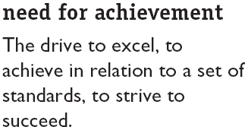
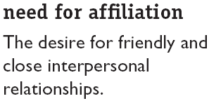
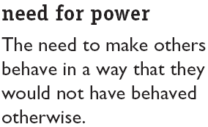
David McClelland’s Theory of Needs
Also called “Acquired-Needs Theory”, states that our needs are acquired or learned on the basis of our life experiences. It is centered on three needs, nAch, nAff, nPow.
nPow
nAch
nAff

Slide 16
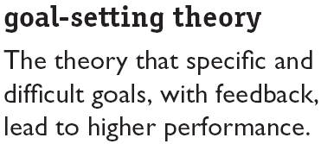

Goal-Setting Theory (Edwin Locke)
Goals tell an employee what needs to be done and how much effort is needed.
Specific hard goals produce a higher level of output than do the generalized goals.
Company’s goal is to secure 70% market share by the end of current year.
A student’s goal is to obtain > 80% marks in all subjects.
Conti…
Company’s goal is to secure 70% market share by the end of current year.

Slide 17
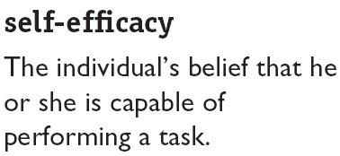
Goal-Setting Theory (Edwin Locke)
In case of participative goal setting, probability of success is very high.
Goal-Setting theory further presupposes that employee commitment will be high when goals are made public, individual has internal locus of control, and when goals are self-set than assigned.
The higher self-efficacy you have, the more confident you will be in your ability to achieve the goals.
SMART GOALS
Subjective goals like “maximum output” are not clear

Slide 18
Reinforcement Theory
Reinforcement theory advocates that behavior is function of its consequences.
It argues that reinforcement conditions behavior.
Reinforcement theory ignores the inner state of an individual and concentrates what solely happens to a person when he/ she takes some action.
Concepts:
Behavior is environmentally caused.
Behavior can be modified (reinforced) by providing (controlling) consequences; e.g. if a bright student is discouraged for hard work due to fear of drop in average (GPA) of the class, he/ she is likely to reduce effort.
Reinforced behavior tends to be repeated.

Slide 19
Job Design Theory
According to this theory, tasks are combined to form complete jobs. The jobs that employees perform should not evolve by chance. Managers design those tasks deliberately and thoughtfully to reflect the demands of changing environment.
Such job designing creates motivation for the performers. Managers can design motivating jobs by following ways:
  Job enlargement – scope is enlarges/expanded
  Job enrichment – job depth increases
  Job characteristics model – five dimensions

Slide 20
Job Design Theory
Job enlargement – it refers to horizontal expansion of job by including more tasks in the relevant area.
Job enrichment – it refers to vertical expansion by adding more responsibilities like, planning, evaluating, aimed at empowering employees and giving them more control over the job. Employees are empowered to do an entire activity with increases freedom, independence & responsibility.
Job characteristics model – managers have used this model to achieve better performance/results by focusing at five core job dimensions:
  Skill variety – job should have a variety of tasks so that a numbers of skills & talents can be used.

Slide 21
Job Design Theory
  Task identity – the degree to which a job requires completion of a whole and identifiable piece of work.
  Task significance – the degree to which a job has a substantial impact on the lives and work of other people.
  Autonomy – the degree to which a job provides substantial freedom, independence & discretion to an employee in scheduling work and determining procedures.
  Feedback – the degree to which doing a job provides its performers timely feedback about how effective his/her performance is.

Slide 22
Equity and Its Impact on Pay Rates
The equity theory of motivation
  States that if a person perceives fairness and equity in the project team, he will continue to work with motivation. However, if the person perceives that there is injustice and inequity, he/she will get demotivated and feel tension and frustration, leading to reduced performance.

Slide 23
Forms of Equity
External equity
  How a job’s pay rate in one company compares to the job’s pay rate in other companies.
Internal equity
  How fair the job’s pay rate is, when compared to other jobs within the same company
Individual equity
  How fair an individual’s pay as compared with what his or her co-workers are earning for the same or very similar jobs within the company.
Procedural equity
  The perceived fairness of the process and procedures to make decisions regarding the allocation of pay.

Slide 24
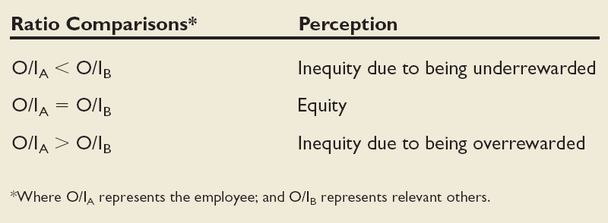
Equity Theory (cont’d)
If we perceive our ratio to be equal to that of the relevant others with whom we compare ourselves, a state of equity is said to exist. We perceive our situation as fair.
When we see the ratio as unequal, we experience equity tension.

Slide 25
Expectancy Theory (Victor Vroom)
Expectancy theory argues that the strength of a tendency to act in a certain way depends on the strength of an expectation that the act will be followed by a given outcome and on the attractiveness of that outcome to the individual.
It says that an employee will be motivated to exert a high level of effort when he/she believes that:
  Effort will lead to a good performance appraisal.
  That a good performance (and good appraisal) will lead to organizational rewards.
  That the rewards will satisfy his/her personal goals.

Slide 26
Expectancy Theory (cont’d)
Three key relationships are:
  Effort-performance relationship. the probability perceived by the individual that exerting a given amount of effort will lead to performance.
  Performance-reward relationship. the degree to which the individual believes that performing at a particular level will lead to the attainment of a desired outcome
  Rewards-personal goals relationship. the degree to which organizational rewards satisfy an individual’s personal goals or needs and the attractiveness of those potential rewards for the individual

Slide 27
THANKS

